Slide 1
UNIT II
Relational Model Constraints
&
Relational Database Schemas
Notes:
https://forms.gle/f4hSuXBKU1g2Xwke6

Slide 2
CHARACTERISTICS OF RELATIONS
Ordering of Tuples in a Relation.
Ordering of Values within a Tuple and an Alternative Definition of a Relation.
Values and NULLs in the Tuples.
Interpretation (Meaning) of a Relation.
are the characteristics of single relations
In a relational data-base, there will typically be many relations, and the tuples in those relations are usually related in various ways.
There are generally many restrictions or constraints on the actual values in a database state.
These constraints are derived from the rules in the mini world that the database represents.

Slide 3
RELATIONAL MODEL CONSTRAINTS
We discuss the various restrictions on data that can be specified on a relational database in the form of constraints.
Constraints are conditions that must hold on all valid relation instances.
There are three main types of constraints:
Constraints that are inherent in the data model. We call these inherent model-based constraints or implicit constraints.
Constraints that can be directly expressed in schemas of the data model, typically by specifying them in the DDL. We call these schema-based constraints or explicit constraints.

Slide 4
3) Constraints that cannot be directly expressed in the schemas of the data model, and hence must be expressed and enforced by the application programs. We call these application-based or semantic constraints or business rules.
Schema-based constraints include:
domain constraints,
key constraints,
constraints on NULLs,
entity integrity constraints, and
referential integrity constraints.

Slide 5
Domain constraints:
They define valid values for attributes
They are the most elementary form of integrity constraint.
They test values inserted in the database..

Slide 6
Domain constraints:
They are the most elementary form of integrity constraint.
They define valid values for attributes.
They test values inserted in the database.
specify that within each tuple, the value of each attribute A must be an atomic value from the domain – i.e., dom (A).
The data types associated with domains typically include standard numeric data types for integers (such as short integer, integer, and long integer) and real numbers (float and double-precision float), Characters, Booleans, fixed-length strings, and variable-length, date, time, timestamp, and money, or other special data types.
Other possible domains may be described by a subrange of values from a data type or as an enumerated data type in which all possible values are explicitly listed.

Slide 7
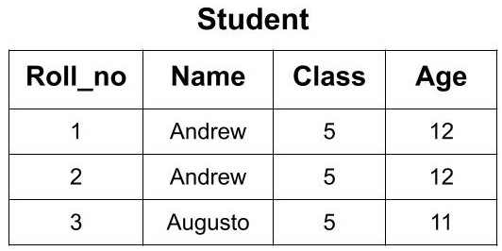
KEYS
If we have the details of students of a classroom stored in Student table as follows:
Now, from this classroom, if we want to select the row of a student whose name is ‘Andrew’.
So, how can we select any specific row?
To do this we must know any property or hint according to which we can easily select any specific row from many rows - the hint which will help us in doing so is the key.
Notes:
Now, from this classroom, if we want to call a student whose name is ‘Andrew’ we don't know which ‘Andrew’ to call as there are two students with the same name. Also, we if know the age of student ‘Andrew’ we can’t distinguish between both the students because both are having the same age. So, there must some value through which we can distinguish and uniquely identify the students. The ‘Roll_no’ attribute will help us in uniquely identifying the rows in a table. We can say that ‘Roll_no’ is the key here. Now, if we know the ‘Roll_no’ of the student then there will be no confusion and we can easily select the student from here.

Slide 8
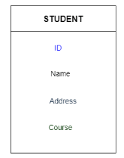
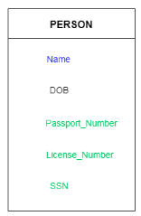
KEYS
Keys play an important role in the relational database.
A key is an attribute or set of attributes which helps us in uniquely identifying the rows of a table.
It is also used to establish and identify relationships between tables.
For example: In Student table, ID is used as a key because it is unique for each student. In PERSON table, passport_number, license_number, SSN are keys since they are unique for each person.

Slide 9
KEYS
Types of key:
Key can be of the following types:
Super Key
Candidate Key
Primary Key
Alternate Key
Foreign Key
Notes:
Key can be of the following types:
Super Key
Candidate Key
Primary Key
Alternate Key
Foreign Key

Slide 10
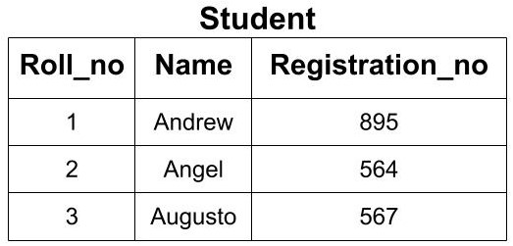
SUPER KEY
A super key or simply key is a combination of all possible attribute which can uniquely identify the rows(tuples) in a table.
Super key is a superset of a candidate key.
This means that a superkey may have some extra attribute which isn't necessary for uniquely identifying the rows in the table.
Example: For the given Student Table, identify all the super keys.
Notes:
Key can be of the following types:
Super Key
Candidate Key
Primary Key
Alternate Key
Foreign Key

Slide 11
SUPER KEY
1) First, list out all the sets of attributes:
{Roll_no}
{Name}
{Registration_no}
{Roll_no, Name} }
{Roll_no, Registration_no},
{Name, Registration_no} }
{Roll_no, Name, Registration_no}
2) Second, eliminate all the sets which do not meet superkey's requirement.
{Name}

Slide 12
SUPER KEY
3) Finally, after elimination, the remaining sets of attributes are the only possible superkeys in this example:
{Roll_no} ✓
{Name} X
{Registration_no} } ✓
{Roll_no, Name} } ✓
{Roll_no, Registration_no}, } ✓
{Name, Registration_no} } ✓
{Roll_no, Name, Registration_no} ✓
All the above keys are able to uniquely identify each row. So, each of these keys is super key.
Here you can see that by using Roll_no only, we can uniquely identify the rows but if you are making a super key, then you will try to find all the possible cases of keys that can be used to identify data uniquely.

Slide 13
SUPER KEY
Denoting one such subset of attributes by SK :
for any two distinct tuples t1and t2 in a relation state r of R, we have the constraint that :
t1[SK]≠t2[SK]

Slide 14
Candidate Key
A candidate key is a minimal super key or a super key with no redundant attribute - that is, a superkey from which we cannot remove any attributes and still have the uniqueness constraint hold. This property is not required by a superkey.
It is called a minimal superkey because we select a candidate key from a set of super key such that selected candidate key is the minimum attribute required to uniquely identify the table.
It is selected from the set of the super key which means that all candidate keys are super key.
Candidate Keys are not allowed to have NULL values.
If the subset of the candidate key is a super key, then that candidate key is not a valid candidate key.
Example: In the above example, we had 6 super keys but all of them cannot become a candidate key. Only those super keys would become a candidate key which have no redundant attributes.

Slide 15
Candidate Key
{Roll_no}: This key doesn't have any redundant or repeating attribute. So, it can be considered as a candidate key.
{Registration_no}: This key also doesn't have any repeating attribute. So, it can be considered as a candidate key.
{Roll_no, Registration_no}: This key cannot be considered as a candidate key because when we take the subset of this key we get two attributes i.e Roll_no or Registration_no. Each of these attributes is the candidate key. So, it is not a minimal super key. Hence, this key is not a candidate key.
{Roll_no, Name}: This key cannot be considered as a candidate key because when we take the subset of this key we get two attributes i.e. Roll_no or Name. Roll_no is a candidate key. So, it is not a minimal super key. Hence, this key is not a candidate key.

Slide 16
Candidate Key
{Name, Registration_no}: This key cannot be considered as a candidate key because when we take the subset of this key we get two attributes i.e Registration_no or Name. Registration_no is a candidate key. So, it is not a minimal super key. Hence, this key is not a candidate key.
{Roll_no, Name, Registration_no}: This key cannot be considered as a candidate key because when we take the subset of this key we get three attributes i.e Roll_no, Registration_no and Name. Two of these attributes i.e Roll_no and Registration_no are the candidate key. So, it is not a minimal superkey. Hence, this key is not a candidate key.
We conclude that we can have only 2 out of above 6 super keys as the candidate key. i.e.
(Roll_no) and
(Registration_no)

Slide 17
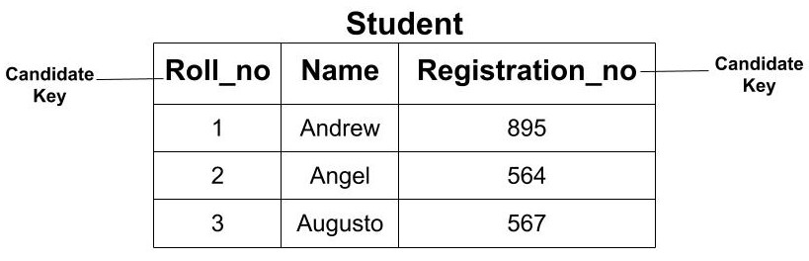
Candidate Key

Slide 18
Primary Key
The primary key is the minimal set of attributes which uniquely identifies any row of a table.
It is selected from a set of candidate keys.
Any candidate key can become a primary key.
The choice of one to become the primary key is somewhat arbitrary; however, it is usually better to choose a primary key with a single attribute or a small number of attributes.
The primary key cannot have a NULL value. It cannot have a duplicate value.
There can be more than one candidate key in relation out of which one can be chosen as the primary key.
We use the convention that the attributes that form the primary key of a relation schema are underlined.
Notes:
There can be more than one candidate key in relation out of which one can be chosen as the primary key. For Example, STUD_NO, as well as STUD_PHONE both, are candidate keys for relation STUDENT but STUD_NO can be chosen as the primary key (only one out of many candidate keys).

Slide 19
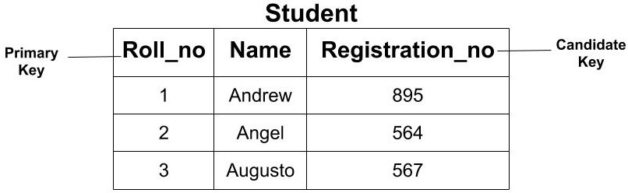
Primary Key
Example: In the above example, we saw that we have two candidate keys i.e (Roll_no) and (Registration_no). From this set, we can select any key as the primary key for our table. It depends upon our requirement.

Slide 20
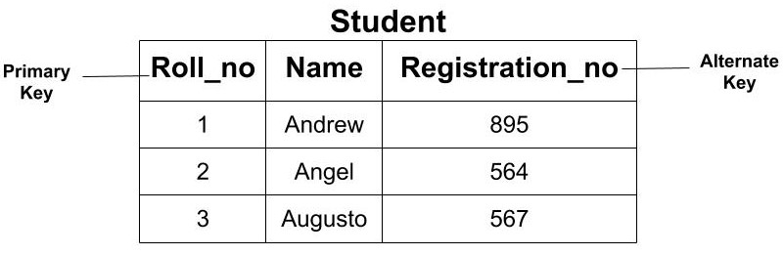
Alternate Key
All the candidate key which are not a primary key are called an alternate key.
Alternate keys may be used like the primary key when doing a single-table select or when filtering in a where clause, but are not typically used to join multiple tables.
Example: In the above example, since we have made ‘Roll_no’ as the Primary Key our Alternate Key would be ‘Registration_no’.
Notes:
Typically, one candidate key is chosen as the primary key. Other candidate keys become alternate keys, each of which may have a UNIQUE constraint assigned to it in order to prevent duplicates (a duplicate entry is not valid in a unique column).^{[3]}
Alternate keys may be used like the primary key when doing a single-table select or when filtering in a where clause, but are not typically used to join multiple tables.

Slide 21
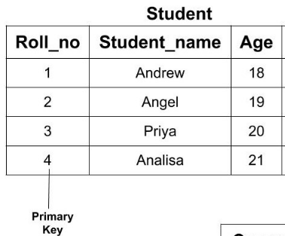
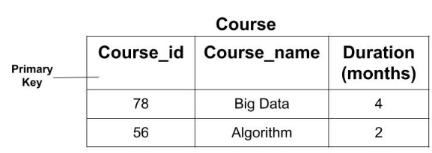
Foreign Key
The foreign key of a table is the attribute which establishes the relationship among tables. The foreign key is the attribute which points to the primary key of another table.
Example: If we have two tables of Student and Course
If we need to find the information about any course opted by any student ?

Slide 22
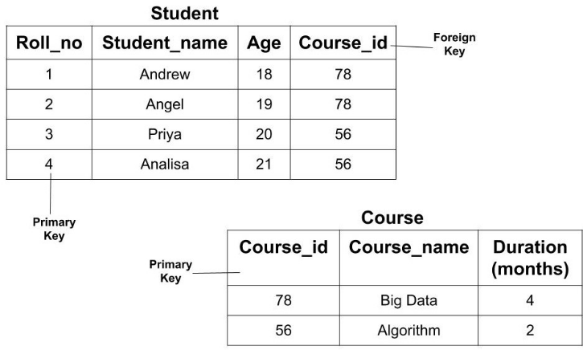
Foreign Key
If we have two tables of Student and Course then we can establish a relationship between these two tables using a foreign key.
The ‘Course_id’ in the Student table is the foreign key as it establishes the link between the Student and Course Table.
So, if we need to find the information about any course opted by any student then we can go the Course table using the foreign key.

Slide 23
Foreign Key
One thing that is to be noted here is that the foreign key of one table may or may not be the primary key. But it should be the primary key of another table.
In the above example, Course_id is not a primary key in the Student table but it is a primary key in the Course table.
Notes:
https://www.tutorialspoint.com/Super-Key-in-RDBMS
https://afteracademy.com/blog/what-are-super-key-primary-key-candidate-key-and-foreign-keys
https://en.wikipedia.org/wiki/Superkey
https://en.wikipedia.org/wiki/Primary_key
https://www.javatpoint.com/dbms-keys
https://www.javatpoint.com/super-key-in-dbms
https://www.geeksforgeeks.org/types-of-keys-in-relational-model-candidate-super-primary-alternate-and-foreign/

Slide 24
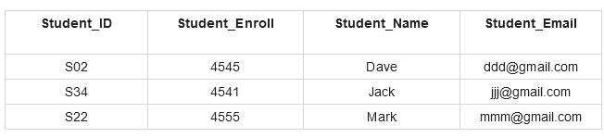
EXAMPLE
For the above table:
Identify all the super keys.
Identify all the candidate keys.
Identify the primary key.
Identify all the alternate keys.
Notes:
https://www.tutorialspoint.com/Super-Key-in-RDBMS
https://afteracademy.com/blog/what-are-super-key-primary-key-candidate-key-and-foreign-keys
https://en.wikipedia.org/wiki/Superkey
https://en.wikipedia.org/wiki/Primary_key
https://www.javatpoint.com/dbms-keys
https://www.javatpoint.com/super-key-in-dbms
https://www.geeksforgeeks.org/types-of-keys-in-relational-model-candidate-super-primary-alternate-and-foreign/

Slide 25
EXAMPLE
The following are the super keys for the above table −
{Student_ID}
{Student_Enroll}
{Student_Email}
{Student_ID, Student_Enroll}
{Studet_ID, Student_Name}
{Student_ID, Student_Email}
{Student_Name, Student_Enroll}
{Student_ID, Student_Enroll, Student_Name}
{Student_ID, Student_Enroll, Student_Email}
{Student_ID, Student_Enroll, Student_Name, Student_Email}

Slide 26
EXAMPLE
The following would be the candidate key from the above −
{Student_ID}
{Student_Enroll}
{Student_Email}

Slide 27
EXAMPLE
The following would be the primary key from the above candidate keys −
{Student_ID}
The following would be the alternate keys from the above candidate keys −
{Student_Enroll}
{Student_Email}

Slide 28
UNIT III
Relational Model Constraints
&
Relational Database Schemas
Notes:
https://forms.gle/orEn3j2fg5yA6mFp8

Slide 29
EXAMPLE
For the above table:
Identify all the super keys.
Identify all the candidate keys.
Identify the primary key.
Identify all the alternate keys.
Notes:
https://www.tutorialspoint.com/Super-Key-in-RDBMS
https://afteracademy.com/blog/what-are-super-key-primary-key-candidate-key-and-foreign-keys
https://en.wikipedia.org/wiki/Superkey
https://en.wikipedia.org/wiki/Primary_key
https://www.javatpoint.com/dbms-keys
https://www.javatpoint.com/super-key-in-dbms
https://www.geeksforgeeks.org/types-of-keys-in-relational-model-candidate-super-primary-alternate-and-foreign/

Slide 30
EXAMPLE
The following are the subsets for the above table −
{Student_ID} {Student_name} {Student_Enroll} {Student_Email}
{Student_ID, Student_Enroll} {Student_ID, Student_Name} {Student_ID, Student_Email}
{Student_Enroll, Student_Name} {Student_Enroll, Student_Email} {Student_Name, Student_Email}
{Student_ID, Student_Enroll, Student_Name} {Student_ID, Student_Enroll, Student_Email}
{Student_ID, Student_Name, Student_email} {Student_Enroll, Student_Name, Student_email}
{Student_ID, Student_Enroll, Student_Name, Student_Email}

Slide 31
EXAMPLE
The following are the super keys for the above table −
{Student_ID}
{Student_Enroll}
{Student_Email}
{Student_ID, Student_Enroll}
{Studet_ID, Student_Name}
{Student_ID, Student_Email}
{Student_Name, Student_Enroll}
{Student_ID, Student_Enroll, Student_Name}
{Student_ID, Student_Enroll, Student_Email}
{Student_ID, Student_Enroll, Student_Name, Student_Email}

Slide 32
EXAMPLE
The following would be the candidate key from the above −
{Student_ID}
{Student_Enroll}
{Student_Email}

Slide 33
EXAMPLE
The following would be the primary key from the above candidate keys −
{Student_ID}
The following would be the alternate keys from the above candidate keys −
{Student_Enroll}
{Student_Email}

Slide 34
INTEGRITY CONSTRAINT
On modeling the design of the relational database we can impose some restrictions like:
what values are allowed to be inserted in the relation,
what kind of modifications are allowed in the relation,
what kind of deletions are allowed in the relation etc.
Integrity constraints.
are a set of rules.
are used to maintain the quality of information.
Integrity constraints ensure that the data insertion, updating, and other processes have to be performed in such a way that data integrity is not affected.
Thus, integrity constraint is used to guard against accidental damage to the database.

Slide 35
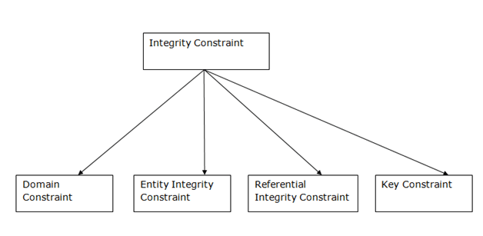
TYPES OF INTEGRITY CONSRAINTS

Slide 36
RECAP
Schema-based constraints include:
Domain Constraints, ✓
Key Constraints, ✓
Constraints On Nulls,
Entity Integrity Constraints and
Referential Integrity Constraints.

Slide 37
NULL CONSTRAINT
When we don’t provide value for a particular column while inserting a record into a table, it takes NULL value by default.
NOT NULL constraint makes sure that a column does not hold NULL value.
By specifying NULL constraint, we can be sure that a particular column(s) cannot have NULL values.
Example:
CREATE TABLE STUDENT(
ROLL_NO INT NOT NULL,
STU_NAME VARCHAR (35) NOT NULL,
STU_AGE INT NOT NULL,
STU_ADDRESS VARCHAR (235),
PRIMARY KEY (ROLL_NO) );

Slide 38
ENTITY INTEGRITY CONSTRAINT
Entity integrity describes a condition in which all tuples within a table are uniquely identified by their primary key.
Entity Integrity constraints states that no primary key can take NULL value,
This is because the primary key value is used to uniquely identify individual tuples in a relation.
Having NULL values for the primary key implies that we cannot identify some tuples/rows.
The unique value requirement prohibits a null primary key value.
To ensure entity integrity :
it is required that every table have a primary key.
Neither the PK nor any part of it can contain null values.

Slide 39
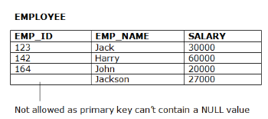
ENTITY INTEGRITY CONSTRAINT
A table can contain a null value other than the primary key field.

Slide 40
REFERENTIAL INTEGRITY CONSTRAINT
Key constraints and entity integrity constraints are specified on individual relations.
The referential integrity constraint is specified between two relations (parent and child); it maintains the correspondence between rows in these tables.
Is used to maintain the consistency among tuples in the two relations.
Informally, the referential integrity constraint states that a tuple in one relation that refers to another relation must refer to an existing tuple in that relation.
This constraint states that a foreign key must have a matching primary key in another table or must be null.
In the Referential integrity constraints, if a foreign key in Table 1 refers to the Primary Key of Table 2, then every value of the Foreign Key in Table 1 must be null or be available in Table 2.

Slide 41
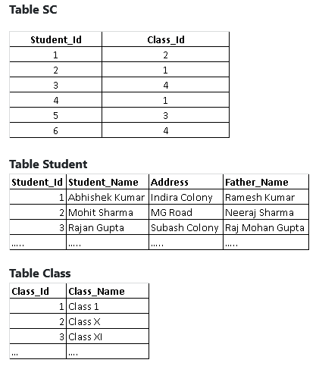
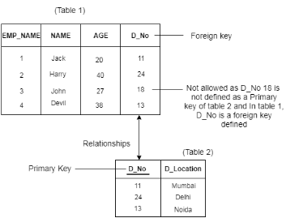
REFERENTIAL INTEGRITY CONSTRAINT

Slide 42
REFERENTIAL INTEGRITY - DEFINITION
A set of attributes FK in relation schema R1is a foreign key of R1that references relation R2 if it satisfies the following rules:
1.The attributes in FK have the same domain(s) as the primary key attributes PK of R2; the attributes FK are said to reference or refer to the relation R2.
2.A value of FK in a tuple t1of the current state r1(R1) either occurs as a value of PK for some tuple t2in the current state r2(R2)or is NULL. In the former case, we have t1[FK] = t2[PK], and we say that the tuple t1 references or refers to the tuple t2.In this definition,R1is called the referencing relation and R2 is the referenced relation.
If these two conditions hold, a referential integrity constraint from R1to R2 is said to hold.
In a database of many relations, there are usually many referential integrity constraints.

Slide 43
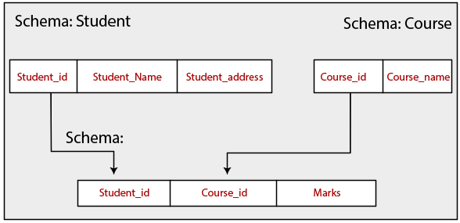
REFERENTIAL INTEGRITY
Examples of referential integrity constraint:
1) Customer(CustID, CustName)
Order(OrderID, CustID, OrderDate)
2) Course(CrsCode, DeptCode, Description)
Class(CrsCode, Section, ClassTime)
We can diagrammatically display referential integrity constraints by drawing a directed arc from each foreign key to the relation it references. For clarity, the arrowhead point to the primary key of the referenced relation.

Slide 44
Update Operations, Transactions & Dealing with Constraint Violations
The operations of the relational model can be categorized into retrievals and updates.
Modification or update operations :
There are three basic operations that can change the states of relations in the data-base: Insert, Delete, and Update (or Modify).
Insert is used to insert one or more new tuples in a relation,
Delete is used to delete tuples, and
Update(or Modify) is used to change the values of some attributes in existing tuples.
Whenever these operations are applied, the integrity constraints specified on the relational database schema should not be violated.

Slide 45
The Insert Operation
The Insert operation provides a list of attribute values for a new tuple that is to be inserted into a relation R.
Insert can violate any of the four types of constraints:
Domain constraints can be violated if an attribute value is given that does not appear in the corresponding domain or is not of the appropriate data type.
Key constraints can be violated if a key value in the new tuple t already exists in another tuple in the relation r(R).
Entity integrity can be violated if any part of the primary key of the new tuple t is NULL.
Referential integrity can be violated if the value of any foreign key in t refers to a tuple that does not exist in the referenced relation. Here are some examples to illustrate this discussion.

Slide 46
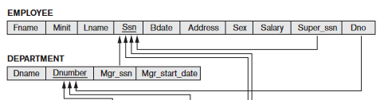
The Insert Operation:
Insert <‘Cecilia’, ‘F’, ‘Kolonsky’,NULL, ‘1960-04-05’, ‘6357 Windy Lane, Katy,TX’, F, 28000,NULL, 4> into EMPLOYEE.
This insertion violates the entity integrity constraint (NULL for the primary key Ssn), so it is rejected
2) Insert <‘Alicia’, ‘J’, ‘Zelaya’, ‘999887777’, ‘1960-04-05’, ‘6357 Windy Lane, Katy,TX’, F, 28000, ‘987654321’, 4> into EMPLOYEE.
This insertion violates the key constraint because another tuple with the same Ssn value already exists in the EMPLOYEE relation, and so it is rejected.

Slide 47
The Insert Operation:
3) Insert <‘Cecilia’, ‘F’, ‘Kolonsky’, ‘677678989’, ‘1960-04-05’, ‘6357 Windswept,Katy, TX’, F, 28000, ‘987654321’, 7> into EMPLOYEE.
This insertion violates the referential integrity constraint specified on Dno in EMPLOYEE because no corresponding referenced tuple exists in DEPARTMENT with Dnumber= 7.
4) Insert <‘Cecilia’, ‘F’, ‘Kolonsky’, ‘677678989’, ‘1960-04-05’, ‘6357 Windy Lane,Katy, TX’, F, 28000,NULL, 4> into EMPLOYEE.
This insertion satisfies all constraints, so it is acceptable.

Slide 48
The Insert Operation:
If an insertion violates one or more constraints :
the default option is to reject the insertion. In this case, it would be useful if the DBMS could provide a reason to the user as to why the insertion was rejected.
Another option is to attempt to correct the reason for rejecting the insertion, but this is typically not used for violations caused by Insert

Slide 49
UNIT II
Relational Model
& Relational Algebra
Notes:
https://forms.gle/UcmYohE8w6bxb2aMA

Slide 50
Update Operations, Transactions & Dealing with Constraint Violations
The operations of the relational model can be categorized into retrievals and updates.
Modification or update operations :
There are three basic operations that can change the states of relations in the data-base: Insert, Delete, and Update (or Modify).
Insert is used to insert one or more new tuples in a relation,
Delete is used to delete tuples, and
Update(or Modify) is used to change the values of some attributes in existing tuples.
Whenever these operations are applied, the integrity constraints specified on the relational database schema should not be violated.

Slide 51
The Insert Operation
The Insert operation provides a list of attribute values for a new tuple that is to be inserted into a relation R.
Insert can violate any of the four types of constraints:
Domain constraints can be violated if an attribute value is given that does not appear in the corresponding domain or is not of the appropriate data type.
Key constraints can be violated if a key value in the new tuple t already exists in another tuple in the relation r(R).
Entity integrity can be violated if any part of the primary key of the new tuple t is NULL.
Referential integrity can be violated if the value of any foreign key in t refers to a tuple that does not exist in the referenced relation. Here are some examples to illustrate this discussion.

Slide 52
The Insert Operation:
Insert <‘Cecilia’, ‘F’, ‘Kolonsky’,NULL, ‘1960-04-05’, ‘6357 Windy Lane, Katy,TX’, F, 28000,NULL, 4> into EMPLOYEE.
This insertion violates the entity integrity constraint (NULL for the primary key Ssn), so it is rejected
2) Insert <‘Alicia’, ‘J’, ‘Zelaya’, ‘999887777’, ‘1960-04-05’, ‘6357 Windy Lane, Katy,TX’, F, 28000, ‘987654321’, 4> into EMPLOYEE.
This insertion violates the key constraint because another tuple with the same Ssn value already exists in the EMPLOYEE relation, and so it is rejected.

Slide 53
The Insert Operation:
3) Insert <‘Cecilia’, ‘F’, ‘Kolonsky’, ‘677678989’, ‘1960-04-05’, ‘6357 Windswept,Katy, TX’, F, 28000, ‘987654321’, 7> into EMPLOYEE.
This insertion violates the referential integrity constraint specified on Dno in EMPLOYEE because no corresponding referenced tuple exists in DEPARTMENT with Dnumber= 7.
4) Insert <‘Cecilia’, ‘F’, ‘Kolonsky’, ‘677678989’, ‘1960-04-05’, ‘6357 Windy Lane,Katy, TX’, F, 28000,NULL, 4> into EMPLOYEE.
This insertion satisfies all constraints, so it is acceptable.

Slide 54
The Insert Operation:
If an insertion violates one or more constraints :
the default option is to reject the insertion. In this case, it would be useful if the DBMS could provide a reason to the user as to why the insertion was rejected.
Another option is to attempt to correct the reason for rejecting the insertion, but this is typically not used for violations caused by Insert

Slide 55
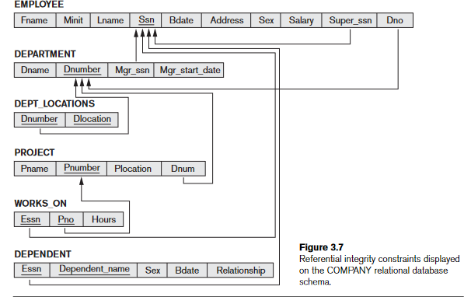

Slide 56
The Delete Operation
The DELETE statement is used to delete rows from a table. Generally, DELETE statement removes one or more records form a table.
The Delete operation can violate only referential integrity.
This occurs if the tuple being deleted is referenced by foreign keys from other tuples in the database.
To specify deletion, a condition on the attributes of the relation selects the tuple (or tuples) to be deleted.
Here are some examples :
Operation: Delete the WORKS_ON tuple with Essn= ‘999887777’ and Pno= 10.
This deletion is acceptable and deletes exactly one tuple.

Slide 57
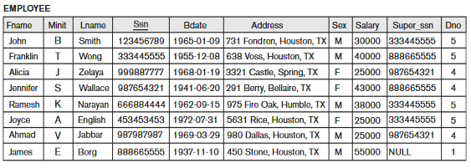
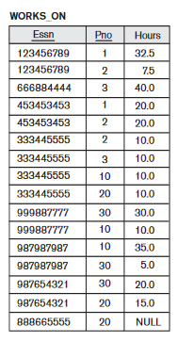
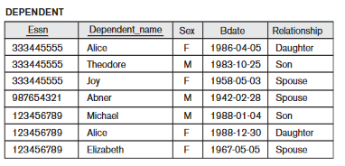
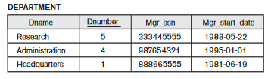
2) Delete the EMPLOYEE tuple with Ssn= ‘999887777’
This deletion is not acceptable, because there are tuples in WORKS_ON that refer to this tuple.
Hence, if the tuple in EMPLOYEE is deleted, referential integrity violations will result.

Slide 58
3) Delete the EMPLOYEE tuple with Ssn= ‘333445555’.
This deletion is not acceptable
This deletion will result in even worse referential integrity violations, because the tuple involved is referenced by tuples from the EMPLOYEE,DEPARTMENT,WORKS_ON, and DEPENDENT relations.

Slide 59
The Delete Operation:
Several options are available if a deletion operation causes a violation.
1) Reject the deletion.
2) Cascade, is to attempt to cascade (or propagate) the deletion by deleting tuples that reference the tuple that is being deleted.
For example, in operation 2, the DBMS could automatically delete the offending tuples from WORKS_ON with Essn= ‘999887777’.
3) set null or set default, is to modify the referencing attribute values that cause the violation; each such value is either set to NULL or changed to reference another default valid tuple. Notice that if a referencing attribute that causes a violation is part of the primary key, it cannot be set to NULL; otherwise, it would violate entity integrity.
4) Combinations of these three options are also possible.
Notes:
In general, when a referential integrity constraint is specified in the DDL, the DBMSwill allow the database designer to specify which of the optionsapplies in case of aviolation of the constraint.

Slide 60
The Update Operation
The Update (or Modify) operation is used to change the values of one or more attributes in a tuple (or tuples) of some relation R.
It is necessary to specify a condition on the attributes of the relation to select the tuple (or tuples) to be modified.
Here are some examples
1) Update the salary of the EMPLOYEE tuple with Ssn= ‘999887777’ to 28000.
Acceptable.
2) Update the Dno of the EMPLOYEE tuple with Ssn= ‘999887777’ to 1.
Acceptable.
3) Update the Dno of the EMPLOYEE tuple with Ssn= ‘999887777’ to 7.
Unacceptable, because it violates referential integrity.
4) Update the Ssn of the EMPLOYEE tuple with Ssn= ‘999887777’ to‘987654321’.
Unacceptable, because it violates primary key constraint by repeating a value that already exists as a primary key in another tuple; it violates referential integrity constraints because there are other relations that refer to the existing value of Ssn

Slide 61
The Update Operation
Updating an attribute that is neither part of a primary key nor of a foreign key usually causes no problems; the DBMS need only check to confirm that the new value is of the correct data type and domain. Modifying a primary key value is similar to deleting one tuple and inserting another in its place because we use the primary key to identify tuples.
Dealing with constraint violations:
Similar options exist to deal with referential integrity violations caused by Update as those options discussed for the Delete operation.

Slide 62
UNIT II
Relational Algebra
Notes:
https://forms.gle/CG5EJmyFzcdZMnK8A

Slide 63
Relational Algebra
There are two formal languages for the relational model:
the relational algebra and
the relational calculus.
The relational algebra and calculus were developed before the SQL language (language for the relational model) .
In some ways, SQL is based on concepts from both the algebra and the calculus.
A data model must include a set of operations to manipulate the database, in addition to the data model’s concepts for defining the database’s structure and constraints.
The basic set of operations for the relational model is the relational algebra.
These operations enable a user to specify basic retrieval requests as relational algebra expressions.

Slide 64
Relational Algebra
The relational algebra is often considered to be an integral part of the relational data model.
Its operations can be divided into two groups.
One group includes set operations from mathematical set theory;
Set operations include UNION, INTERSECTION, SET DIFFERENCE, and CARTESIAN RODUCT(also known as CROSS PRODUCT).
The other group consists of operations developed specifically for relational databases — include SELECT,PROJECT, and JOIN, among others.
SELECT and PROJECT operations are unary operations that operate on single relations.
JOIN and other complex binary operations, which operate on two tables by combining related tuples (records) based on join conditions.

Slide 65
Relational Algebra
Relational Algebra are divided in various groups :
Unary Relational Operations
SELECT (symbol: σ)
PROJECT (symbol: π)
RENAME (symbol: ρ)
Relational Algebra Operations From Set Theory
UNION (υ)
INTERSECTION (∩),
DIFFERENCE (-)
CARTESIAN PRODUCT ( x )
Binary Relational Operations
JOIN
DIVISION

Slide 66
Unary Relational Operations: SELECT
The SELECT Operation (symbol: σ)
Is used to choose a subset of the tuples from a relation that satisfies a selection condition.
The SELECT operation can be considered to be a filter that keeps only those tuples that satisfy a qualifying condition.
The SELECT operation can also be visualized as a horizontal partition of the relation into two sets of tuples—those tuples that satisfy the condition and are selected, and those tuples that do not satisfy the condition and are discarded.
In general, the SELECT operation is denoted by :
σ <selection condition>(R)
where the symbol σ(sigma) is used to denote the SELECT operator
the selection condition is a Boolean expression (condition) specified on the attributes of relation R.

Slide 67
Unary Relational Operations: SELECT
The SELECT Operation
The Boolean expression specified in <selection condition> is made up of a number of clauses of the form:
<attribute name> <comparison op> <constant value> or
<attribute name> <comparison op> <attribute name>
where <attribute name> is the name of an attribute of R,
<comparison op> is normally one of the operators =, <, ≤, >, ≥, ≠ and <constant value> is a constant value from the attribute domain. Clauses can be connected by the standard Boolean operators and, or, and not to form a general selection condition.
The relation resulting from the SELECT operation has the same attributes as R.

Slide 68
Unary Relational Operations: SELECT
The SELECT Operation
σ topic = "Database" (Tutorials)
Output - Selects tuples from Tutorials where topic = 'Database'.
σ topic = "Database" and author = “Navathe” ( Tutorials)
Output - Selects tuples from Tutorials where the topic is 'Database' and 'author' is Navathe.
σ sales > 50000 (Customers)
Output - Selects tuples from Customers where sales is greater than 50000
σ Dno=4(EMPLOYEE)
σ Salary>30000(EMPLOYEE)
σ (Dno=4 AND Salary>25000) OR (Dno=5 AND Salary>30000) (EMPLOYEE)

Slide 69
Unary Relational Operations: SELECT
The SELECT Operation
The result of a SELECT operation can be determined as follows.
The<selection condition> is applied independently to each individual tuple t in R. This is done by substituting each occurrence of an attribute Ai in the selection condition with its value in the tuple t[Ai]. If the condition evaluates to TRUE, then tuple ti is selected.
All the selected tuples appear in the result of the SELECT operation.

Slide 70
Unary Relational Operations: SELECT
The SELECT Operation
The SELECT operator is unary; that is, it is applied to a single relation.
The degree of the relation resulting from a SELECT operation—its number of attributes—is the same as the degree of R .
The number of tuples in the resulting relation is always less than or equal to the number of tuples in R. That is, |σc(R)|≤|R| for any condition C.
The fraction of tuples selected by a selection condition is referred to as the selectivity of the condition
The SELECT operation is commutative; that is ,σ<cond1>(σ<cond2>(R)) =σ<cond2>(σ<cond1>(R))
We can always combine a cascade(or sequence) of SELECT operations into a single SELECT operation with a conjunctive (AND) condition; that is
σ<cond1>(σ<cond2>(...(σ<condn>(R))...)) = σ<cond1>AND<cond2>AND...AND<condn>(R)

Slide 71
Unary Relational Operations: PROJECT
The PROJECT Operation:
If we think of a relation as a table, the SELECT operation chooses some of the rows from the table while discarding other rows.
The PROJECT operation, on the other hand, selects certain columns from the table and discards the other columns.
If we are interested in only certain attributes of a relation, we use the PROJECT operation to project the relation over these attributes only.
Therefore, the result of the PROJECT operation can be visualized as a vertical partition of the relation into two relations: one has the needed columns (attributes) and contains the result of the operation, and the other contains the discarded columns.

Slide 72
Unary Relational Operations: PROJECT
The PROJECT Operation:
The general form of the PROJECT operation is:
π<attribute list>(R)
where π(pi) is the symbol used to represent the PROJECT operation, and <attribute list> is the desired sub list of attributes from the attributes of relation R.
R is, in general, a relational algebra expression whose result is a relation, which in the simplest case is just the name of a database relation.
The result of the PROJECT operation has only the attributes specified in <attribute list> in the same order as they appear in the list. Hence, its degree s equal to the number of attributes in <attribute list>

Slide 73
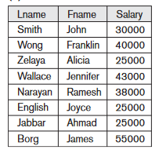
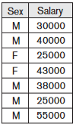
Unary Relational Operations: PROJECT
The PROJECT Operation:
The PROJECT operation removes any duplicate tuples, so the result of the PROJECT operation is a set of distinct tuples, and hence a valid relation.
This is known as duplicate elimination.
For example, to list each employee’s first and last name and salary, we can use the PROJECT operation as follows: πLname,Fname,Salary(EMPLOYEE) π Sex,Salary (EMPLOYEE)

Slide 74
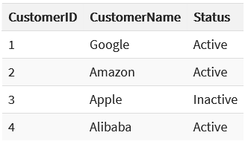
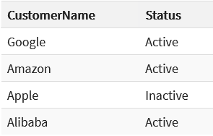
Unary Relational Operations: PROJECT
The PROJECT Operation:
Consider the following table
Π CustomerName, Status (Customers)

Slide 75
Unary Relational Operations: PROJECT
The PROJECT Operation:
The number of tuples in a relation resulting from a PROJECT operation is always less than or equal to the number of tuples in R.
If the projection list is a super key of R—that is, it includes some key of R—the resulting relation has the same number of tuples as R.
Moreover,π<list1>(π<list2>(R)) =π<list1>(R)as long as <list2> contains the attributes in <list1>; otherwise, the left-hand side is an incorrect expression.
Commutativity does not hold on PROJECT.

Slide 76
Relational Algebra Operations from Set Theory
The next group of relational algebra operations are the standard mathematical operations on sets.
The UNION, INTERSECTION & SET DIFFERENCE(also called MINUS or EXCEPT) operations.
Used to merge the elements of two sets in various ways.
These are binary operations – i.e. each is applied to two sets(of tuples).
The two relations on which any of these three operations are applied must have the same type of tuples; this condition has been called union compatibility or type compatibility.
Two relations R(A1,A2, ...,An) and S(B1,B2, ...,Bn) are said to be union compatible(or type compatible) if they have the same degree n and if dom (Ai) = dom (Bi) for 1<=i<=n.
This means that the two relations have the same number of attributes and each corresponding pair of attributes has the same domain

Slide 77
Relational Algebra Operations from Set Theory
The three operations UNION, INTERSECTION, and SET DIFFERENC Eon two union-compatible relations R and S can be defined as follows:
UNION:
The result of this operation, denoted by R∪S, is a relation that includes all tuples that are either in R or in S or in both R and S.
Duplicate tuples are eliminated.
INTERSECTION:
The result of this operation, denoted by R∩S, is a relation that includes all tuples that are in both R and S.
SET DIFFERENCE (or MINUS):
The result of this operation, denoted by R–S, is a relation that includes all tuples that are in R but not in S.

Slide 78
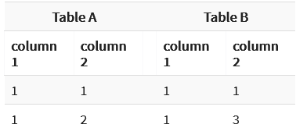
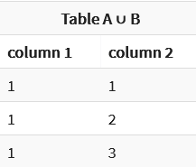
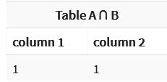
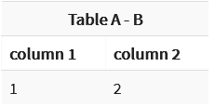
Relational Algebra Operations from Set Theory
Example

Slide 79
Relational Algebra Operations from Set Theory
Both UNION and INTERSECTION are commutative operations;
i.e., R∪S=S∪R and R∩S=S∩R
Both UNION and INTERSECTION can be treated as n-ary operations applicable to any number of relations because both are also associative operations;
i.e., R ∪(S∪T)=(R∪S)∪T and (R∩S)∩T=R∩(S∩T)
The MINUS operation is not commutative.
i.e., R−S≠S−R
Note that INTERSECTION can be expressed in terms of union and set difference as follows:
R ∩ S=((R∪S)−(R−S))−(S−R)

Slide 80
The CARTESIAN PRODUCT Operation
Also known as CROSS PRODUCT or CROSS JOIN—which is denoted by X.
This is also a binary set operation, but the relations on which it is applied do not have to be union compatible.
In its binary form, this set operation produces a new element by combining every member (tuple) from one relation (set) with every member (tuple) from the other relation (set).
In general, the result of R(A1,A2, ...,An)×S(B1,B2, ...,Bm) is a relation Q with degree n+m attributes Q(A1,A2, ...,An,B1,B2, ...,Bm), in that order.
The resulting relation Q has one tuple for each combination of tuples—one from Rand one from S. Hence, if R has nR tuples (denoted as |R| = nR), and S has nS tuples, then :
R×S will have nR*nS tuples.
The CARTESIAN PRODUCT creates tuples with the combined attributes of two relations.
Notes:
https://www.guru99.com/relational-algebra-dbms.html
https://beginnersbook.com/2019/02/dbms-relational-algebra/

Slide 81
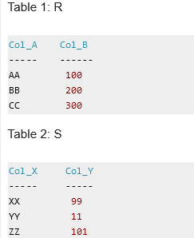
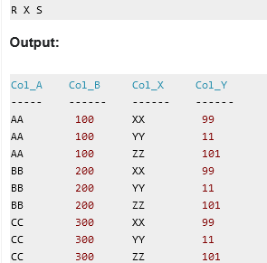
The CARTESIAN PRODUCT Operation
Notes:
https://www.guru99.com/relational-algebra-dbms.html

Slide 82
RELATIONAL ALGEBRA QUERIES - EXAMPLES
2ND July 2021
Notes:
https://forms.gle/waX6ptncnYHPBRJu6 – Session 1
https://forms.gle/sW2kWsfarB2ZU53Z6 - Session 2

Slide 83
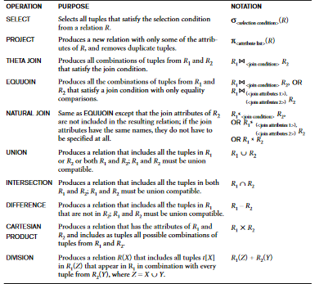
Operations of Relational Algebra

Slide 84
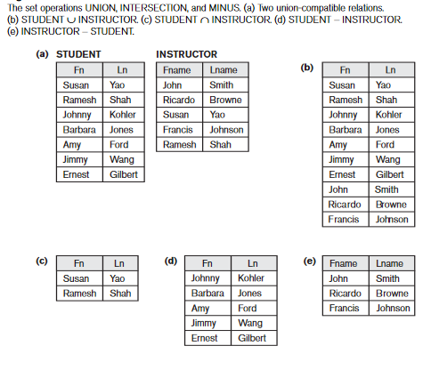
Operations FROM SET THEORY

Slide 85
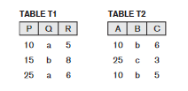
Operations of Relational Algebra
Consider the two tables T1 and T2. Show the results of the set operations:
T1 U T2 T1 ∩ T2 = null set
T1-T2 T2-T1 T1 x T2
P | Q | R
10 | a | 5
15 | b | 8
25 | a | 6
10 | b | 6
25 | c | 3
10 | b | 5
P | Q | R | A | B | C
10 | a | 5 | 10 | b | 6
10 | a | 5 | 25 | c | 3
10 | a | 5 | 10 | b | 5
15 | b | 8 | 10 | b | 6
15 | b | 8 | 25 | c | 3
15 | b | 8 | 10 | b | 5
25 | a | 6 | 10 | b | 6
25 | a | 6 | 25 | c | 3
25 | a | 6 | 10 | b | 5
P | Q | R
10 | a | 5
15 | b | 8
25 | a | 6
A | B | C
10 | b | 6
25 | c | 3
10 | b | 5

Slide 86
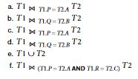
Operations of Relational Algebra
Consider the two tables T1 and T2. Show the results of the following operations:
c)
a)
d)
b)
f)
P | Q | R | A | B | C
10 | a | 5 | 10 | b | 6
10 | a | 5 | 10 | b | 5
25 | a | 6 | 25 | c | 3
15 | b | 8 | NULL | Null | Null
P | Q | R | A | B | C
10 | a | 5 | 10 | b | 6
10 | a | 5 | 25 | c | 3
10 | a | 5 | 10 | b | 5
15 | b | 8 | 10 | b | 6
15 | b | 8 | 25 | c | 3
15 | b | 8 | 10 | b | 5
25 | a | 6 | 10 | b | 6
25 | a | 6 | 25 | c | 3
25 | a | 6 | 10 | b | 5
P | Q | R | A | B | C
10 | a | 5 | 10 | b | 6
10 | a | 5 | 10 | b | 5
25 | a | 6 | 25 | c | 3
P | Q | R | A | B | C
15 | b | 8 | 10 | b | 5
15 | b | 8 | 10 | b | 6
NULL | NULL | NULL | 25 | a | 6
P | Q | R | A | B | C
15 | b | 8 | 10 | b | 6
15 | b | 8 | 10 | b | 5
P | Q | R | A | B | C
10 | a | 5 | 10 | b | 5

Slide 87
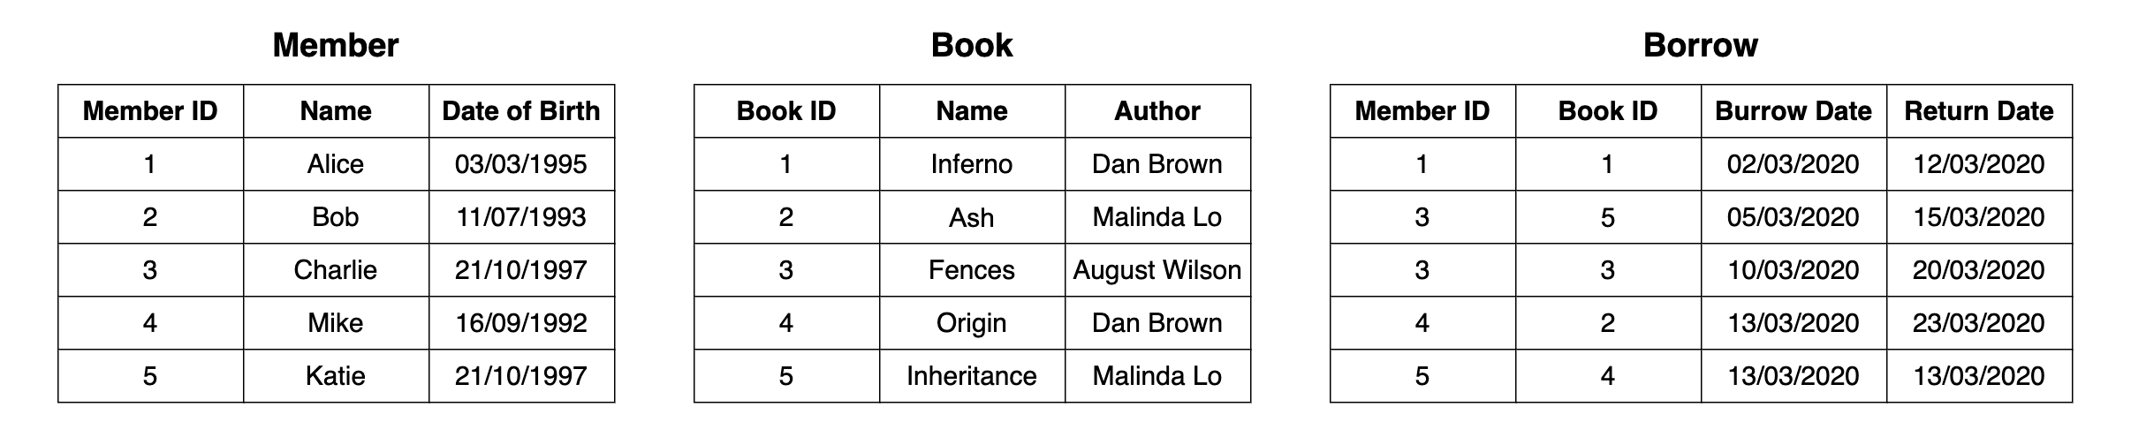
EXAMPLE
Write relational algebraic expressions for the following queries:
IDs of members who have borrowed books
IDs of members and the Book IDs of the books they have borrowed.
Details of the members who were born on 21/10/1997.
Borrowing details of members with ID = 3
Borrowing details of members who have borrowed a book with ID 1 or 5
Notes:
https://towardsdatascience.com/a-quick-guide-to-relational-algebra-operators-in-dbms-1ff2ddecaad7

Slide 88
EXAMPLE
Write relational algebraic expressions for the following queries:
6) Name of the books(s) authored by Dan Brown or Malinda Brown
7) Name of the books(s) authored by Dan Brown and Malinda Brown
8) ID and DOB of member Charlie
9) Names of member’s & authors whose ID’s are the same *
10) Names of all members & authors

Slide 89
EXAMPLE
Write relational algebraic expressions for the following queries:
11) Book IDs of the books borrowed by Charlie and Mike.
12) Member IDs of the members who have borrowed both the books “Fences” and “Inheritance”.
13) Member IDs of the members who have never borrowed books.

Slide 90
Additional Relational Operations
4th July 2020
Notes:
Session 1 - https://forms.gle/p3YrJZFFhuEmrLfr5
Session 2 - https://forms.gle/BxcmYZ5ycmJfRde87

Slide 91
Aggregate Functions
An aggregate function performs a calculation on a set of values, and returns a single value.
These functions are used in simple statistical queries that summarize information from the database tuples.
Common functions applied to collections of numeric values include SUM,AVERAGE,MAXIMUM, and MINIMUM. The COUNT function is used for counting tuples or values.
Except for COUNT(*), aggregate functions ignore null values.
Aggregate functions are often used with the GROUP BY clause of the SELECT statement.

Slide 92
Grouping
Another common type of request involves grouping the tuples in a relation by the value of some of their attributes and then applying an aggregate function independently to each group.
An example would be to group EMPLOYEE tuples by Dno:
so that each group includes the tuples for employees working in the same department.
We can then list each Dno value along with, say, the average salary of employees within the department, or the number of employees who work in the department.

Slide 93
Aggregate Functions and Grouping
We can define an AGGREGATE FUNCTION operation, using the symbol ℑ (pronounced script F), to specify these types of requests as follows:
<grouping attributes>ℑ <function list> (R)
where <grouping attributes> is a list of attributes of the relation specified in R, and
<function list> is a list of (<function> <attribute>) pairs.
In each such pair,<function> is one of the allowed functions- such as SUM, AVERAGE,MAXIMUM,MINIMUM,COUNT—and <attribute> is an attribute of the relation specified by R.
The resulting relation has the grouping attributes plus one attribute for each element in the function list.

Slide 94
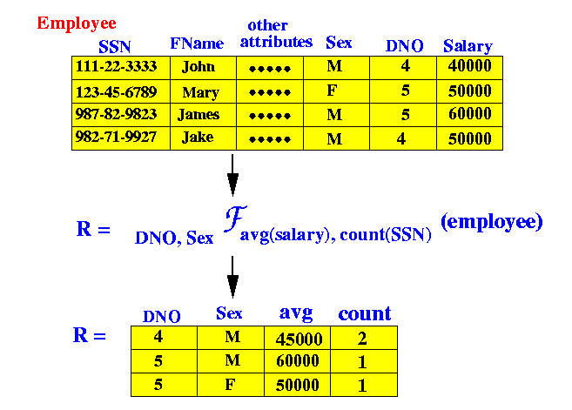
EXAMPLE

Slide 95
EXAMPLE

Slide 96
Example
Suppose we have the following relational database:
employee (person name, street, city)
works(person name, company name, salary)
company (company name, city)
(a) Find the names of all employees who live in city ‘Miami’.
(b) Find the names of all employees whose salary is greater than $100,000.
(c) Find the names of all employees who live in ‘Miami’ and whose salary is greater than $100,000.
(d) Find the names of all employees who work for “First Bank Corporation”.
(e) Find the names and cities of residence of all employees who work for “First Bank Corporation”.
(f) Find the names, street address, and cities of residence of all employees who work for “First Bank Corporation” and earn more than $10,000.

Slide 97
Example
Suppose we have the following relational database:
employee (person name, street, city)
works(person name, company name, salary)
company (company name, city)
(a) Find the names of all employees who live in city ‘Miami’.
Πperson name(σcity=’Miami’(employee))
(b) Find the names of all employees whose salary is greater than $100,000.
Πperson name(σsalary>100000(works)
(c) Find the names of all employees who live in ‘Miami’ and whose salary is greater than $100,000.
Πperson name(σcity=’Miami’∧salary>100000(employee on works))
(d) Find the names of all employees who work for “First Bank Corporation”.
Πperson name(σcompany name=‘First Bank Corporation’(works))

Slide 98
Example
d) Find the names of all employees who work for “First Bank Corporation”.
Πperson name(σcompany name=‘First Bank Corporation’(works))
(e) Find the names and cities of residence of all employees who work for “First Bank Corporation”.
Πperson name,city(σcompany name=‘First Bank Corporation’(works on employee))
(f) Find the names, street address, and cities of residence of all employees who work for “First Bank Corporation” and earn more than $10,000.
Πperson name,street,city(σcompany name=‘First Bank Corporation’∧salary>10000(employee on works))

Slide 99
Example
Give the following queries in the relational algebra using the relational schema
student(id, name)
enrolledIn(id, code)
subject(code, lecturer)
What are the names of students enrolled in cs3020?
Which subjects is Hector taking?
Who teaches cs1500?
Who teaches cs1500 or cs3020?
Who teaches at least two different subjects?
Notes:
1

Slide 100
Example
6. What are the names of students in cs1500 or cs3010?
7. What are the names of students in both cs1500 and cs1200?
8. What are the names of students in at least two different subjects?
9. What are the codes of all the subjects taught?
10. What are the names of all the students?
11. What are the names of all the students in cs1500?
12. What are the names of students taking a subject taught by Roger.
13. What are the names of students who are taking a subject not taught by Roger?
Notes:
1

Slide 101





Example
Give the following queries in the relational algebra using the relational schema
student(id, name)
enrolledIn(id, code)
subject(code, lecturer)
What are the names of students enrolled in cs3020?
Which subjects is Hector taking?
Who teaches cs1500?
Who teaches cs1500 or cs3020?
Who teaches at least two different subjects?
Notes:
1

Slide 102






Example
6. What are the names of students in cs1500 or cs3010?
7. What are the names of students in both cs1500 and cs1200?
8. What are the names of students in at least two different subjects?
9. What are the codes of all the subjects taught?
10. What are the names of all the students?
11. What are the names of all the students in cs1500?
12. What are the names of students taking a subject taught by Roger.
13. What are the names of students who are taking a subject not taught by Roger?

